Slide 1

Understanding Suicide Data in Wales
National Programme for Suicide and Self-Harm Prevention
December 2024

Slide 2

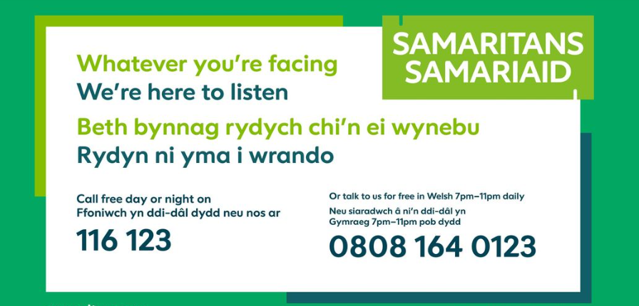
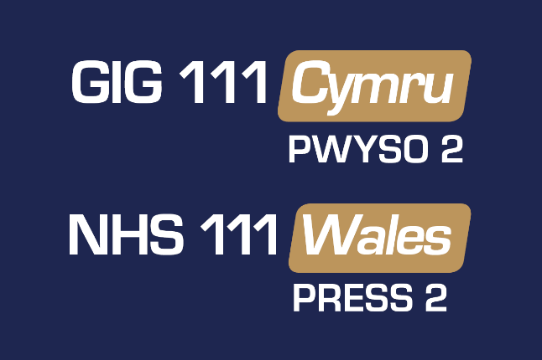
Self-care and safety
any discussion around suicide and self-harm can be distressing
these slides may raise issues that make you feel uncomfortable
please look after yourself, and step away if you need to
if you feel you need immediate support, please contact a help-line:
Freephone: 0800 132 737
Text help to: 81066

Slide 3

Contents
ONS annual statistical bulletins (registrations)
ONS annual statistical bulletins (occurrences)
Real Time Suspected Suicide Surveillance (RTSSS) Wales
Implications for suicide prevention
Contact details

Slide 4
Data are people
While talking about population-level data it is important to remember that each number is an individual whose death may have been preventable, and whose death will be having a significant and enduring impact on many others
Notes:
Sometimes speaking about people’s lives, or the end of life, in numbers or statistics can sound or feel insensitive. This is to acknowledge that for each number there is an individual who has been lost, and possibly a family or community that has been devastated

Slide 5
Things to consider when using suicide data
while all suicide deaths are significant events, compared to other major causes of death, such as heart disease or cancers, numbers can seem relatively small, particularly when looking at numbers in a single year
if that single year dataset is made smaller still e.g.: by dividing further by sex, age-bands, geographical area, or those combined, it becomes increasingly difficult to draw conclusions, or to make meaningful comparisons from one year to another
more can be learned from observing trends in the data over several years
Notes:
Sometimes speaking about people’s lives, or the end of life, in numbers or statistics can sound or feel insensitive. This is to acknowledge that for each number there is an individual who has been lost, and possibly a family or community that has been devastated

Slide 6
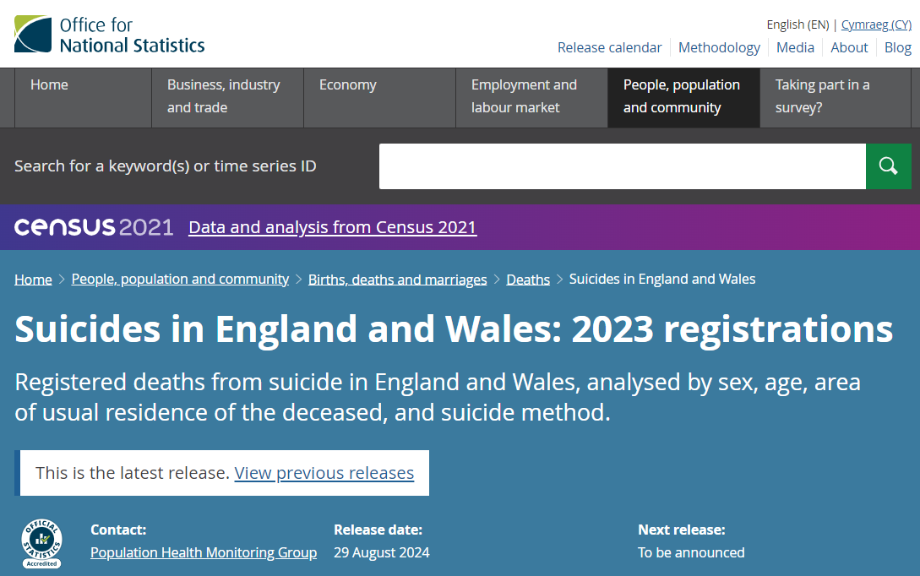
Statistical bulletins from Office for National Statistics (ONS)
Deaths registered in-year after coroner inquest
(published annually)
Back to Contents
⇨
Notes:
The slides that follow will present data published by the Office for National Statistics (ONS). This statistical bulletin is usually published in September every year, but it was delayed until December in 2023
The statistics relate to the number of deaths in the year 2022, that were registered with suicide as the cause of death, as confirmed by the coroner

Slide 7
ONS Data
data available from 1981
reported annually, January to December (calendar year data)
reports on previous year (2024 report presents 2023 data)
reports coroner confirmed death registrations in-year (In 2023, 39% of deaths registered occurred in 2023, 51% in 2022, and 10% in 2021 or earlier)
three quarters of deaths are males (consistent since mid 90’s)
386 death registrations recorded for Wales in 2023
2023 saw an increase in registrations of 7.6% for England and Wales
Source:
Suicides in England and Wales - Office for National Statistics (ons.gov.uk)
Notes:
This slide sets out what the ONS annual statistical bulletin provides and what data is used in the reports. The ONS hold data relating to death registrations i.e.: post-inquest, coroner confirmed deaths by suicide
The advantage of this dataset is that there is now over 40 years of data which enables us to identify trends and patterns over time – such as the proportion of male suicides
The number of deaths registered in any given year is affected by the extent of the delays relating to registration. Some delays in Wales are longer than a year, and this will affect the figures

Slide 8
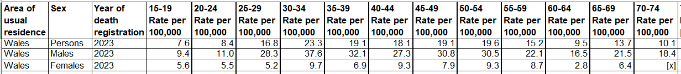
ONS rates (2023)
deaths per 100,000 (all-persons for Wales 14/100,000)
age-standardised rates - allows for differences in the age-structure of populations so that valid comparisons can be made
rates differ in different groups – males 22/100,000, females 6.3/100,000
rates differ in ages and at different age intervals (five-year groups below)
!Caution! small numbers - the smaller the group the more caution needed in interpreting the data
Source:
Suicides in England and Wales - Office for National Statistics (ons.gov.uk)
Notes:
This slide talks about rates rather than numbers
It shows that while there is a rate for the whole population (12.5/100,000), there are different rates for males and females, for different age groups, and for different geographical areas. Depending on how you divide up the information, the rate will be different
This table shows that breakdown of sex and age can reveal rates much higher than the national rate, and taking five-year age ranges will generate a different rate again, for example: males 35-39 rate 36.4/100,000
What this slide doesn’t show you is that the highest rate is for men over 90 (60.3/100,000) representing 6 registered deaths by suicide in 2022

Slide 9
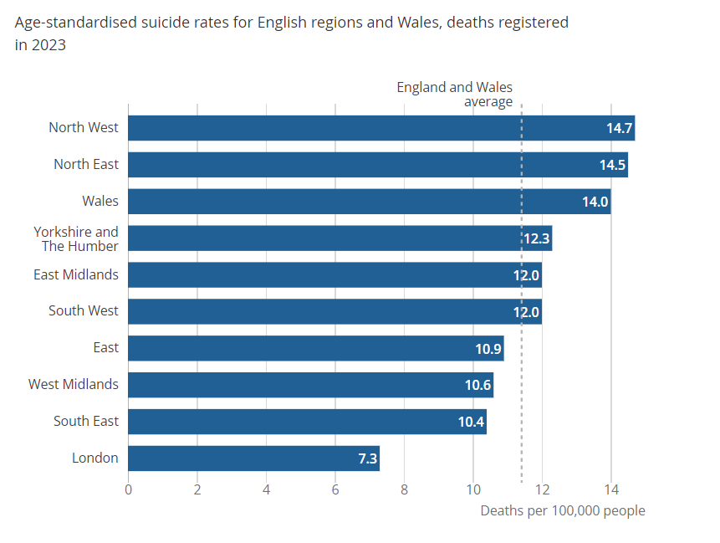
ONS rates (2023) comparing England and Wales
Each regions position can change year-to-year
In 2023, the rate of suicide registrations in Wales was almost twice the rate in London
Source:
Suicides in England and Wales - Office for National Statistics (ons.gov.uk)
Notes:
This slide shows how the rates in Wales compare to all regions in England and Wales
Over the last two years Wales has moved nearer to the top, though this list can change every year and is based on suicide death registrations for all regions
Although Wales has moved higher up in the list than last year, the national rate has reduced slightly. This illustrates how changeable data is relating to suicide

Slide 10
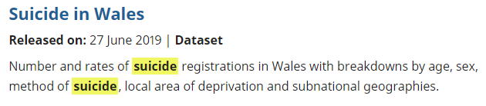
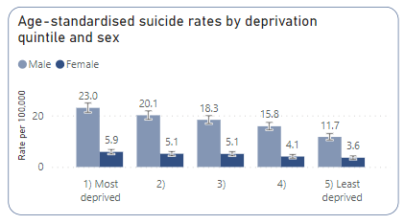
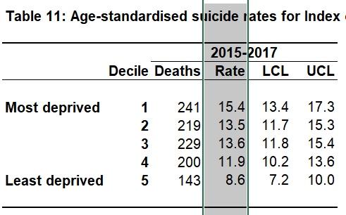
ONS rates and deprivation
Power BI Dashboard
from ONS data 2012 - 2021
Rate of suicide in our most deprived communities is almost twice the rate in our least deprived communities
Source:
Suicide in Wales - Office for National Statistics (ons.gov.uk) published 27 June 2019
Notes:
For deprivation, the ONS published a report in 2019, reporting on suicide death registrations between 2015 and 2017 in Wales. This clearly shows that the rate of suicide in the most deprived areas in Wales is almost double that in the least deprived – there is a clear gradient
The middle table has been taken from our Power BI Dashboard that we use as a team to be able to analyse the data, and it draws on ONS registrations data for the last 10 years (2012 – 2021) – and again, this shows a clear gradient from most deprived to least
For the most up-to-date presentation of data the RTSSS also reports on deprivation, but the gradient is less clear – this is because the dataset is small – but the difference between the most deprived and the least is still evident
This should indicate to us where our efforts should be focussed in relation to postvention and prevention

Slide 11
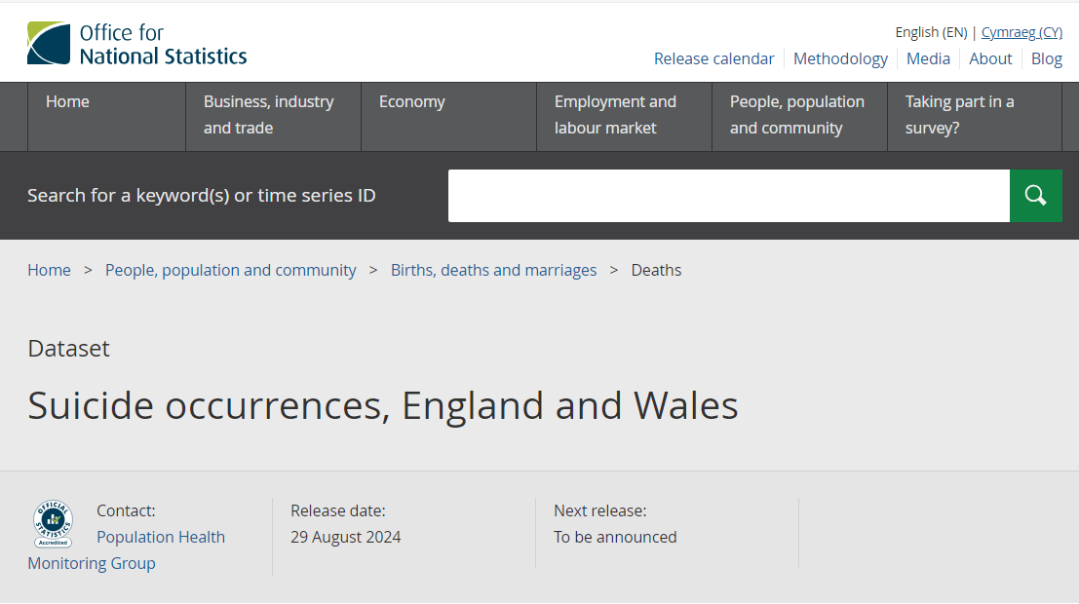
Statistical bulletins from Office for National Statistics (ONS)
Suicide occurrences in-year
(published annually)
Back to Contents
⇨
Notes:
The slides that follow will present data published by the Office for National Statistics (ONS). This statistical bulletin is usually published in September every year, but it was delayed until December in 2023
The statistics relate to the number of deaths in the year 2022, that were registered with suicide as the cause of death, as confirmed by the coroner

Slide 12
ONS occurrences
data available from 1981
updated annually
confirmed registrations but reported by year of death (not year of registration)
ONS report published in 2024 presents data up to 2022 (due to registration delays) so a retrospective dataset
As registrations reported to ONS, records continually updated so dataset changes over time
Notes:
This slide shows that the ONS produces several different reports from the registration data
See search: https://www.ons.gov.uk/search?q=suicide
ONS publishes a report of death occurrences every year. Using the registration data (coroner confirmed deaths) it reports the data for the year in which the person died (date of death). Because each death has to be confirmed as a suicide by the coroner, how up to date this information can be is determined by the registration delays. This is why this report only goes up to 2021
While we already have ONS data on the number of deaths in any year, we still need the RTSSS (real time suspected suicide surveillance) system to tell us this more quickly, even if it records the deaths that the police suspect are probable suicides. The cause of death could change depending on the coroner’s verdict

Slide 13
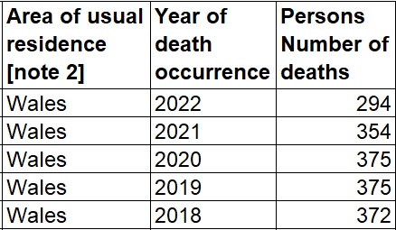
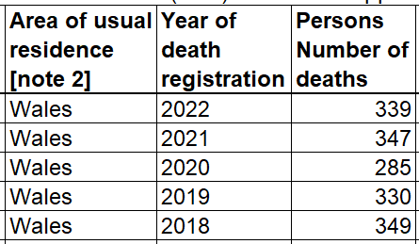
ONS data: suicide occurrences and registrations
numbers can change every year as registrations become known and records up-dated
2024 bulletin reports up to 2022 due to registration delays
registrations for same years

Slide 14
Other ONS reports - Wales
Suicide by occupation 2011-2015 ages 20-64 (Jun 2019)
Major group occupations:
Males – skilled trade occupations, and unskilled
Females – caring, leisure and other service occupations
Caution needed in interpreting data presented over a limited age-range ( working-age cohort) and four-year time-range (2011-2015)
Consideration to be given to vulnerability to suicide in those who are unemployed or experiencing financial strain
Source: Suicide by occupation: Wales - Office for National Statistics (ons.gov.uk) published June 2019
Notes:
Again – looking at some of the other reports that the ONS has published, one focusses on occupation, and this was published in 2019 using registration data from 2011-2015 for Wales
This gives us some indication, at a high level, of where we might want to focus some of our prevention efforts, or at least find out more about those who might be at higher risk. Note the five year time-frame for the data and the date of publication (the report relates to data over 5 years old)
The ONS publishes different reports, and different reports for England and Wales. Some of the reports can be produced for England because of the higher numbers due to the larger population (population Wales 3.2 million, population England over 56 million). Some reports cannot be produced, or with the same frequency for Wales, because the numbers are too low for the data to be statistically significant and therefore reliable

Slide 15
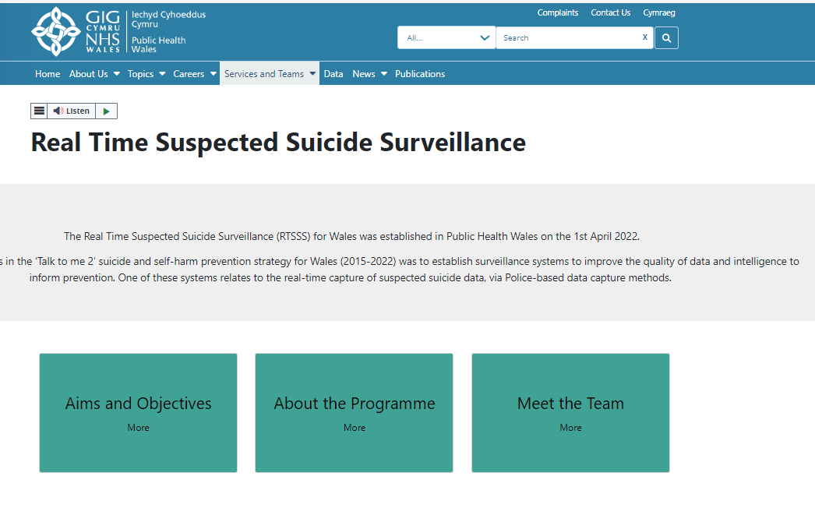
Real-time suspected suicide surveillance (RTSSS) WALES sudden and unexplained deaths, as they occur, thought to be a possible suicide
Back to Contents
⇨
Notes:
The slides that follow relate to the first year report from the real time suspected suicide surveillance (RTSSS) programme for Wales, published on 11th January 2024 and available on the Public Health Wales website

Slide 16








RTSSS dataset in Wales
police reported sudden deaths that are suspected suicides
collated monthly, and reviewed monthly by national/regional leads
second report 10th December 2024: April 2023 – March 2024
data published annually due to ‘small’ numbers (statistically) (England can publish monthly as monthly number of deaths are similar to annual numbers in Wales)
data are deaths in Welsh population (whether death occurs in Wales or elsewhere, so non-residents not included)
reports crude rates and not age-standardised rates
Notes:
This slide sets out the timeframe of the first RTSSS report and offers an opportunity to talk about the small size of the dataset and the risks about drawing conclusions – this is explained clearly in the full report available on-line (hyper-linked in the slide) Deaths by suspected suicide 2022-23 - Public Health Wales (nhs.wales)
England are also reporting on their RTSSS data (both systems based on a GB-wide system set up by the British Transport Police). England can report monthly because they have around 350 suspected suicide deaths a month (Wales has c.350 a year). They will not report more frequently as the numbers will become too low for meaningful analysis, and Wales will only be reporting annually for the same reason

Slide 17

RTSSS: second annual report April 2023 – March 2024
! Caution ! small time-limited dataset
350 deaths (rate for all persons 12.4/100,000) over 12-month period
76% of deaths were in males
highest age-specific rate was males 35-44 (35.6/100,000)
regionally, North Wales had the highest rate, but this was not statistically different from the all-Wales rate
inequalities prevail – rates in most deprived areas (15.8/100,000) were significantly higher than the all-Wales rate, and the rate in the least deprived areas (8.6/100,000)
Notes:
While this data relates to suspected suicides (as identified by front-line police officers), the number and national rate (whole population) over a 12-month period is within the expected range that is reported annually through recorded death registrations (ONS)
While rates/numbers are generally not rising (as far as we can tell given the fluidity of the data), they are also persisting (not declining)
While the highest rate was males 35-44 the rate was very similar in males aged 25-34 which challenges the common narrative about middle-aged men

Slide 18







RTSSS – associated factors (! drawn from small dataset!)
63% mental health condition
20% domestic abuse perpetrator
53% previous history of self-harm
24% alcohol or substance use
65% previously known to police
24%
Long-term illness/ disability/pain
26%
relationship issues
13%
bereavement
Annual Report: Deaths by suspected suicide 2023-24 - Public Health Wales
Notes:
Most of these associated factors are already recognised from other datasets and we’ve known about them for a long time
Some of those who died may have been affected by a number of these at the same time, and we know that individual suicides are associated with multiple factors. The ‘Talk to me 2’ strategy states that there is no single reason why someone may take their own life. This is why multi-agency partnerships are so important for suicide prevention
The RTSSS provides additional insight into the links to domestic abuse and the number who have died who are previously known to the police (this could be for different reasons – not necessarily being suspected or convicted of a crime). This reflects findings in other RTSSS systems in other parts of the UK

Slide 19
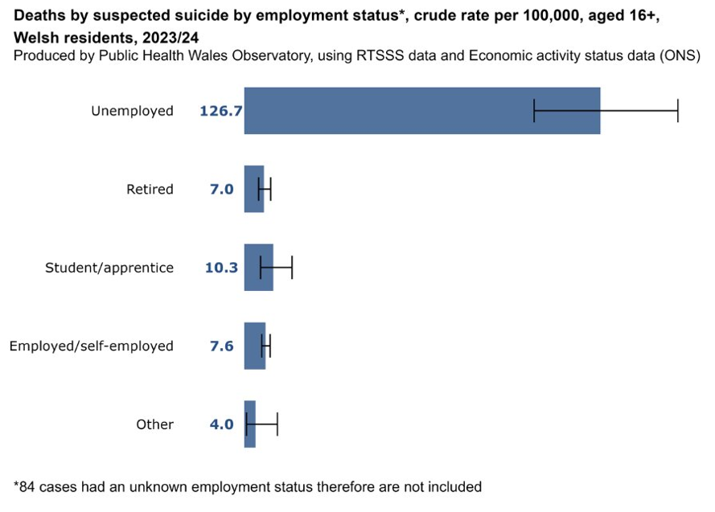
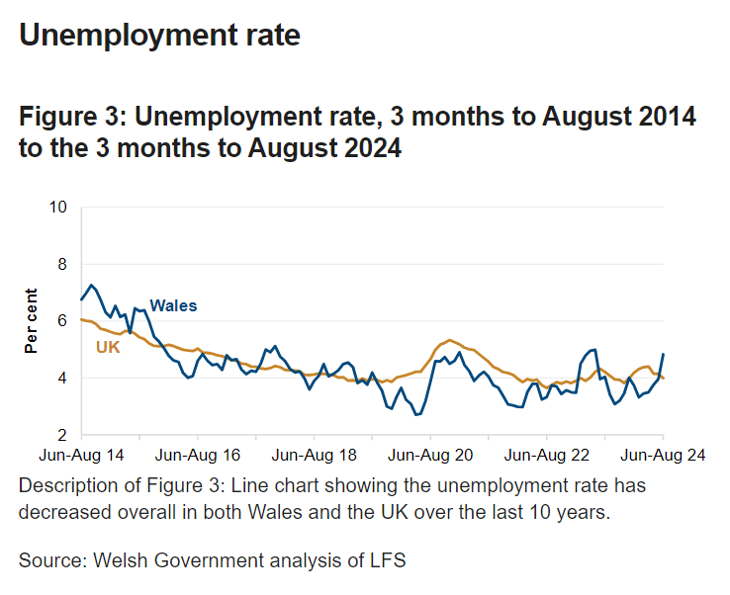

RTSSS - unemployment
Source: Annual Report: Deaths by suspected suicide 2023-24 - Public Health Wales
Source: Labour Market Overview: October 2024 (headline results) [HTML] | GOV.WALES
Notes:
Another stand-out observation in the RTSSS dataset was that the rate of unemployment was significantly higher than for any other employment group
While overall rates of unemployment have generally been going down across the UK this can conceal more localised variations where there are fewer prospects for secure or stable work. As an antecedent to suicide, this information should inform our approaches to suicide prevention

Slide 20
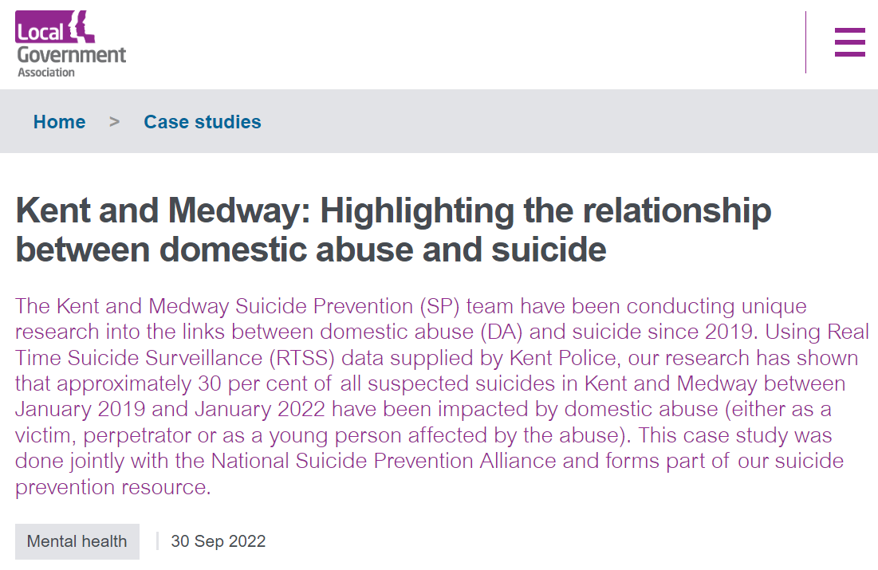
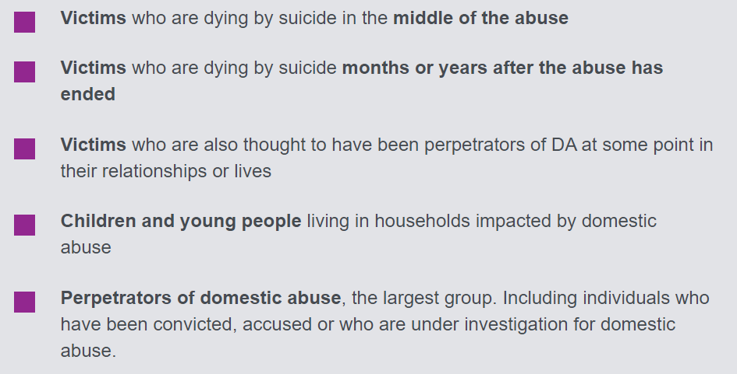

Learning from other RTSSS systems
Kent and Medway: Highlighting the relationship between domestic abuse and suicide | Local Government Association
Notes:
Kent County Council (Public Health Teams are in top-tier local authorities in England) has analysed their Real Time Surveillance (RTS) data to explore the links to domestic abuse
Kent and Medway: Highlighting the relationship between domestic abuse and suicide | Local Government Association
They make recommendations for other areas including the training of mental health staff in domestic abuse, and the training of domestic abuse workers in suicide prevention. Their work has also informed the inclusion of domestic abuse in the new English suicide prevention strategy for the first time
Suicide prevention strategy: action plan - GOV.UK (www.gov.uk)

Slide 21
Implications for prevention – using different datasets
ONS data
accurate, but not as timely (reported annually)
coroner confirmed death registrations
40 years of data showing long-term trends relating to risk factors, groups, and places that can inform planned prevention measures (proactive)
reports age-adjusted rates that allows for comparisons between groups and geographical areas that have different age profiles in their populations
RTSSS data
timely (reported monthly) but not as accurate
police identified suspected suicides
1 year of data showing most recently observed associated factors
enables more timely response to those bereaved or affected, and to identify clusters (reactive)
reports crude or absolute rates which can help to determine how much resource is needed to act effectively. It is not as suitable for comparing between areas
Notes:
While we have the data presented in these slides, we also have research that helps us to understand suicide, and self-harm, who is society may be vulnerable to suicide, and what we can do to help them
We know that far more men than women die by suicide.
We know that people have often been in contact with health services – not just mental health services, but primary care or emergency departments in the days and weeks leading up to their death, so there are opportunities for intervention that we might be missing
We know that people’s circumstances are important, and these can be affected by many things including public policy, the economic climate, availability of suitable and stable employment. These are more difficult to address from a prevention point of view, but there may be ways in which people experiencing these challenges can be helped to access better support more easily

Slide 22
Implications for prevention
proportion of male suicides and complexity around their needs
significance of socio-economic factors such as living alone; relationship issues; loss or bereavement; unemployment; living in more deprived or under-served communities
significance of behavioural factors such as substance use, being exposed to violence/abuse
potentially higher risk occupations (M – trades, F – caring/service)
opportunities to respond in mental health services and wider health and care system
Notes:
While we have the data presented in these slides, we also have research that helps us to understand suicide, and self-harm, who is society may be vulnerable to suicide, and what we can do to help them
We know that far more men than women die by suicide.
We know that people have often been in contact with health services – not just mental health services, but primary care or emergency departments in the days and weeks leading up to their death, so there are opportunities for intervention that we might be missing
We know that people’s circumstances are important, and these can be affected by many things including public policy, the economic climate, availability of suitable and stable employment. These are more difficult to address from a prevention point of view, but there may be ways in which people experiencing these challenges can be helped to access better support more easily

Slide 23



Implications for prevention
review evidence of effective interventions (male suicide prevention) and develop mechanisms to hear male voices in Wales, to shape how we respond to needs and improve access to support
work with colleagues in mental health services and primary care, and other front-line agencies to respond appropriately, based on evidence and continued learning, and to enable effective signposting to options for support
recognise areas of disadvantage/under-served communities to focus provision and support e.g.: support after suicide, and work with agencies that help people to manage financial challenges, unemployment, housing
strengthen links with other policy areas such as substance use, domestic abuse, to identify opportunities for intervention and support in the context of complex lives and needs
Notes:
Research recently published on Antecedents and service contact in an observational study of 242 suicide deaths in middle-aged men in England, Scotland and Wales, 2017 | BMJ Public Health found that while we often say that men do not seek help, most men in this study were found to be in contact with support services shortly before they died
We need to look at how we can respond to, and support men, better
We need to look at how we are responding to people who present to different parts of our health and care system, and equip our front-line workers to deliver an appropriate response through training and service development
We need to make sure support offers and systems are accessible and available to those who may live in under-served communities

Slide 24
Acknowledgements
Professor Ann John
Public Health and Psychiatry Health Data Science, Swansea University
Dr Rosalind Reilly
RTSSS Programme Lead, Public Health Wales
Kim Swain
Knowledge and Analytical Services, Welsh Government
David Mais
Office for National Statistics
Claire Cotter
National Programme Lead for suicide and self-harm prevention, NHS Wales Executive

Slide 25
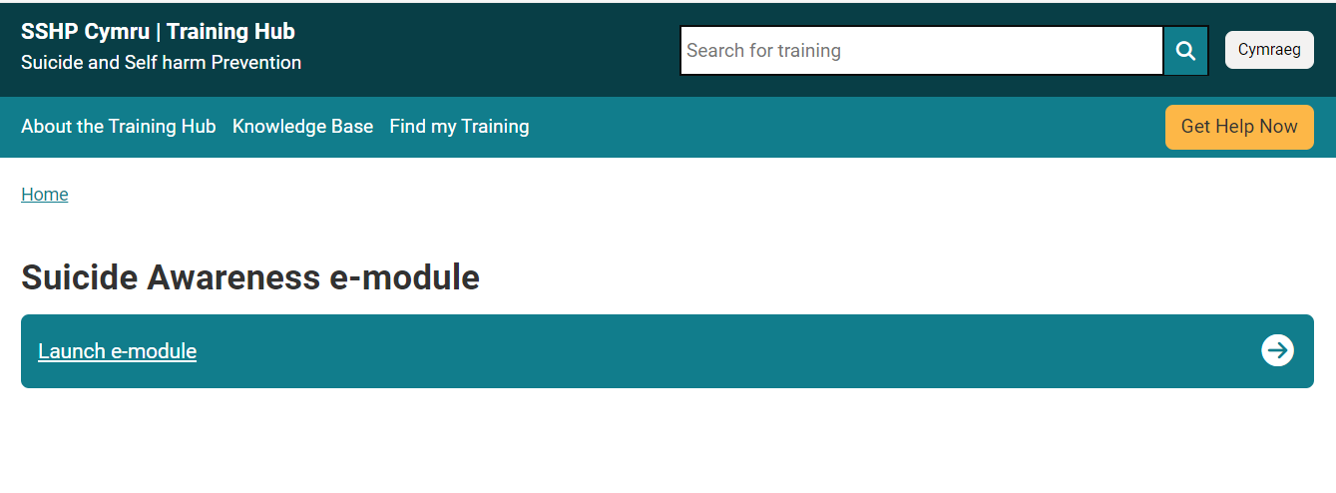
If you want to know more about suicide prevention in Wales

Slide 26
If you want to know more about suicide prevention in Wales
National Suicide and Self-harm Prevention Strategy for Wales [DRAFT]
https://www.gov.wales/draft-suicide-and-self-harm-prevention-strategy
National Advisory and Liaison Service for Wales
(for those who have been affected by a sudden or unexplained death that might be a suicide)
https://nals.cymru/
Help is at Hand Cymru
(an online resource for those who have been affected by a sudden death that might be a suicide)
https://www.sshp.wales/en/help-is-at-hand/
Knowledge and evidence base (SSHP Cymru Digital HUB)
https://www.sshp.wales/en/knowledge-base/

Slide 27
If you want to know more about suicide prevention in Wales
Samaritans Cymru
https://www.samaritans.org/samaritans-cymru/
PAPYRUS Prevention of Young Suicide
https://www.papyrus-uk.org/contact-us/ (to find offices in Wales)
MIND Cymru
https://www.mind.org.uk/about-us/mind-cymru-mind-in-wales/

Slide 28
To contact the national SSHP Programme team: sshp.cymru@wales.nhs.uk
To contact the national RTSSS team:
PHW.RTSSS@wales.nhs.uk
Contact details
Back to Contents
⇨

